Slide 1


Decentralized Online Shopping
Decentralized online shopping uses blockchain technology and direct connections between buyers and sellers. This new way of shopping can be more open, safe, and fair.

Slide 2

The Limitations of Traditional E-commerce
1
Centralized Control
2
High Transaction Fees
Traditional e-commerce platforms are controlled by centralized entities, leading to potential manipulation and limited transparency.
Centralized platforms often charge high fees for transactions, making it expensive for businesses and consumers.
3
Data Privacy Concerns
4
Limited Accessibility
User data is often collected and used without explicit consent, raising concerns about privacy and security.
Not everyone has equal access to online platforms, leaving many individuals and communities excluded from the benefits of e-commerce.

Slide 3
Benefits of Decentralized Systems
Open Records
Lower Costs
More Security
All the details are recorded publicly, so it's easy to see how things are moving around.
Decentralized platforms don't need middlemen, so transaction fees are lower for businesses and customers.
Blockchain tech protects against fraud and changes, making online transactions safer.

Slide 4
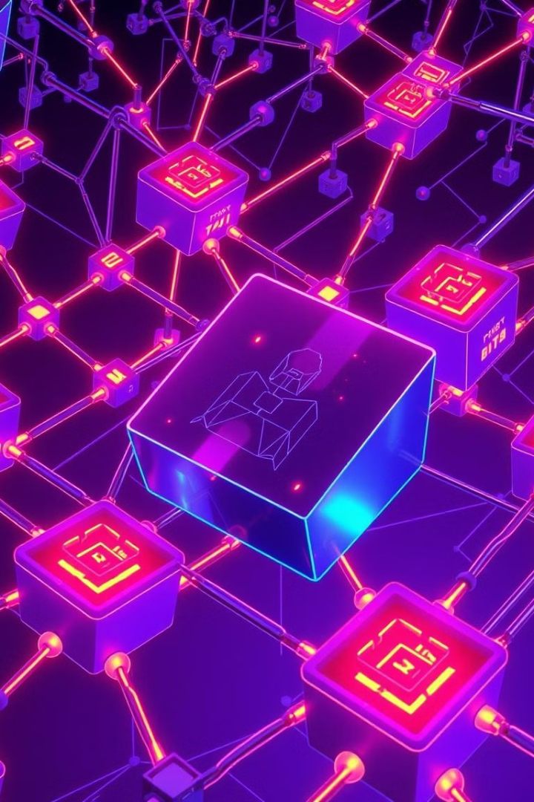
Blockchain in Online Shopping
Recorded Transactions
1
All the buying and selling is recorded on a shared list. This makes the info safe and hard to change.
Automatic Agreements
2
Computers can make deals without people involved. This makes the process faster and easier.
Tokenization
3
Digital assets are represented by tokens, enabling seamless transfer and ownership of goods and services.

Slide 5

Direct Buying and Selling
People Connect Directly
1
Buyers and sellers work together without middlemen, which makes things easier.
Automatic Deals
2
Computers can make deals without people involved. This makes the process faster and simpler.
Secure Transactions
3
Deals are protected by special codes, so you don't need to trust other people.

Slide 6

Open Markets Without Central Control
Made by the People
More Competition
Helping Small Businesses
Open markets are built with code that anyone can use and improve.
Open markets increase competition, leading to lower prices and better services for customers.
Open markets give small businesses a chance to reach more customers and compete equally.

Slide 7
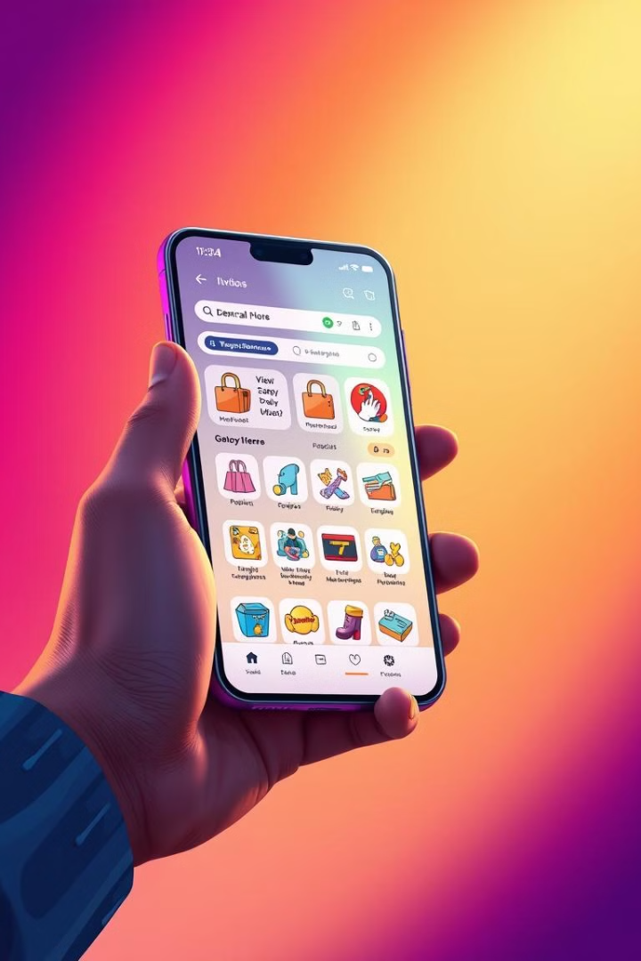




Empowering Consumers and Merchants
Lower Costs
Increased Security
Reduced transaction fees and elimination of intermediaries lead to lower costs for both buyers and sellers.
Blockchain technology safeguards transactions, protecting against fraud and data breaches.
Greater Transparency
More Freedom
Publicly auditable transactions enhance trust and accountability in the marketplace.
Decentralized platforms provide greater control over data and empower individuals to participate in a more equitable economy.

Slide 8
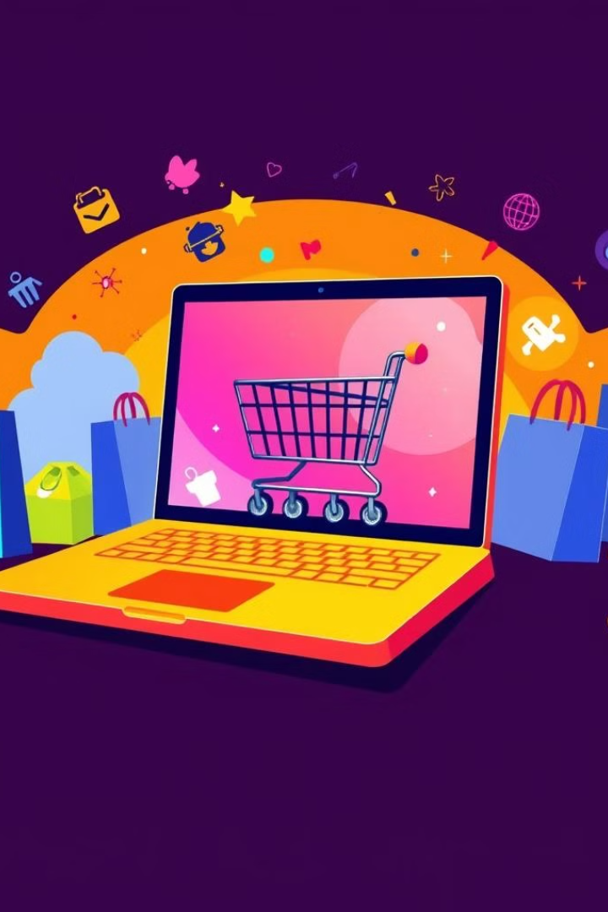
Open Online Shopping
1
Personalized Experience
Shopping suggestions that protect your privacy
2
Global Payments
Easy payments anywhere in the world
3
More Control
Digital IDs give you more control
4
Freedom for Sellers
New ways for sellers to do business
These changes can create a better future for open online shopping, helping both buyers and sellers.

Slide 9
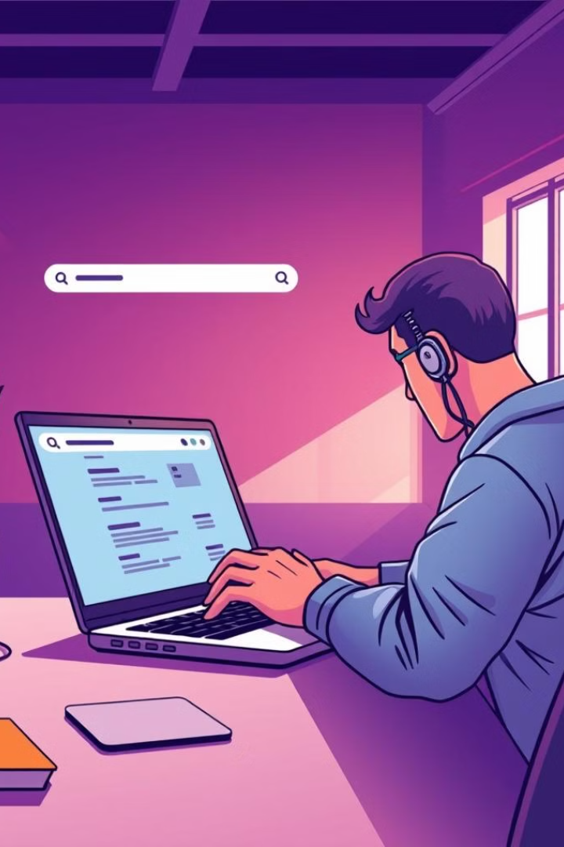
Future Enhancement
Decentralized online shopping systems are constantly evolving, leading to exciting possibilities for future enhancements:
Increased Scalability
Improving blockchain technology and network infrastructure for greater transaction volume and complex applications.
Advanced Smart Contracts
Enabling sophisticated automated agreements for streamlined shopping.
1
2
3
Seamless User Experience
Developing intuitive interfaces and tools to simplify decentralized shopping.

Slide 10
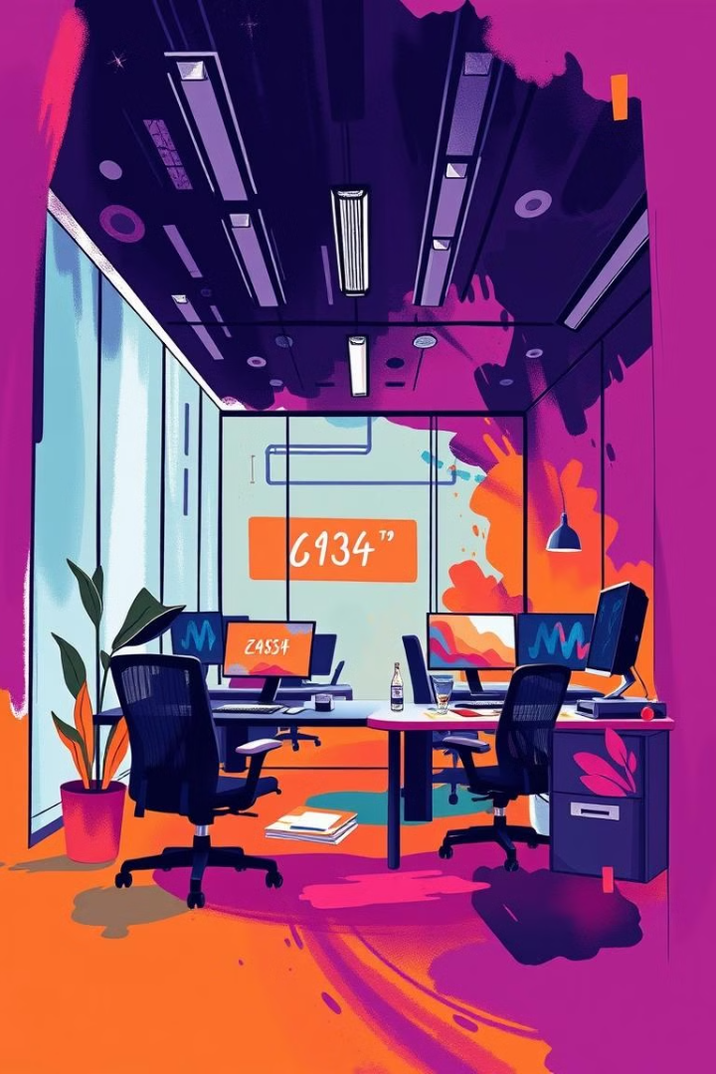
Thank You!

